Slide 1



BuDb: A Curated Drug Discovery Database for Buruli Ulcer
Presentation by:
Daniel Tweneboah Anyimadu

Slide 2
Contents
Introduction
Problem Statement
Need Statement
Construction of BuDb & Content
Results
Conclusion
1
6
2
7
3
4

Slide 3
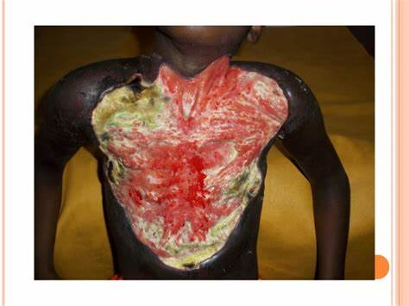
Introduction
Buruli ulcer (BU), is an ulcerative and chronic skin disease caused by Mycobacterium ulcerans.
BU can lead to permanent disability.
BU ranks the third most prevalent mycobacterial disease behind tuberculosis and leprosy.

Slide 4
Introduction
Presently, BU is reported in over 33 countries worldwide.
BU has been classified as a neglected tropical disease by the World Health Organization (WHO).
Africa
Australia

Slide 5


Problem Statement
Also, the advent of treatment-resistant isolates is alarming which calls for new remedies.
1
There are few treatment options to BU.
2
Several online repositories for mycobacterial species have been developed.
This is to consolidate drug discovery data.
3
4

Slide 6
Problem Statement
Their dependability has helped researchers discovered promising drugs.
5
Datasets on M. ulcerans, however, are unformatted and widely scattered across different resources.
6

Slide 7
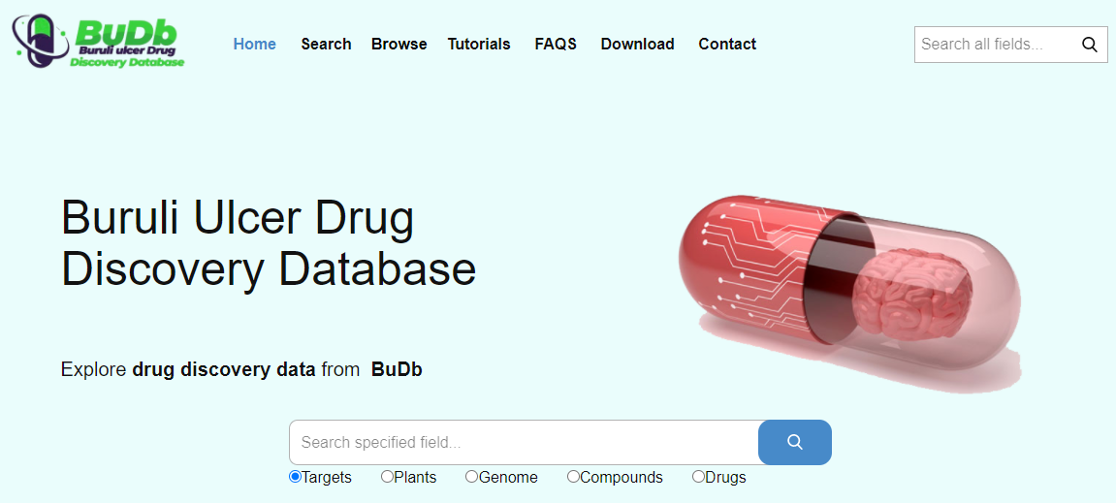
Need Statement
A more pragmatic trend is to develop a disease (BU) specific database.
Here, we present Buruli ulcer database (BuDb), which serves as “a one-stop” knowledge base and a dedicated resource for BU drug discovery.

Slide 8
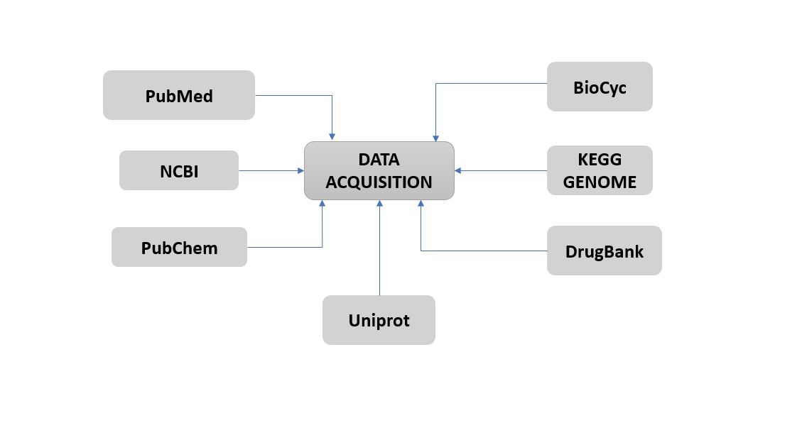
Construction of BuDb & Content
BuDb was created by first curating data from biological databases and journal articles.
The datasets provide comprehensive information on the various drug targets, tested compounds, existing drugs, ethnopharmacological plants and information on the genome of M. ulcerans.

Slide 9
Construction of BuDb & Content
Regarding the architectural framework for the database, BuDb was built on Apache HTTP server and uses MySQL server to store data.
The responsive front-end query is implemented in JavaScript, PHP, HTML5 and CSS3.

Slide 10
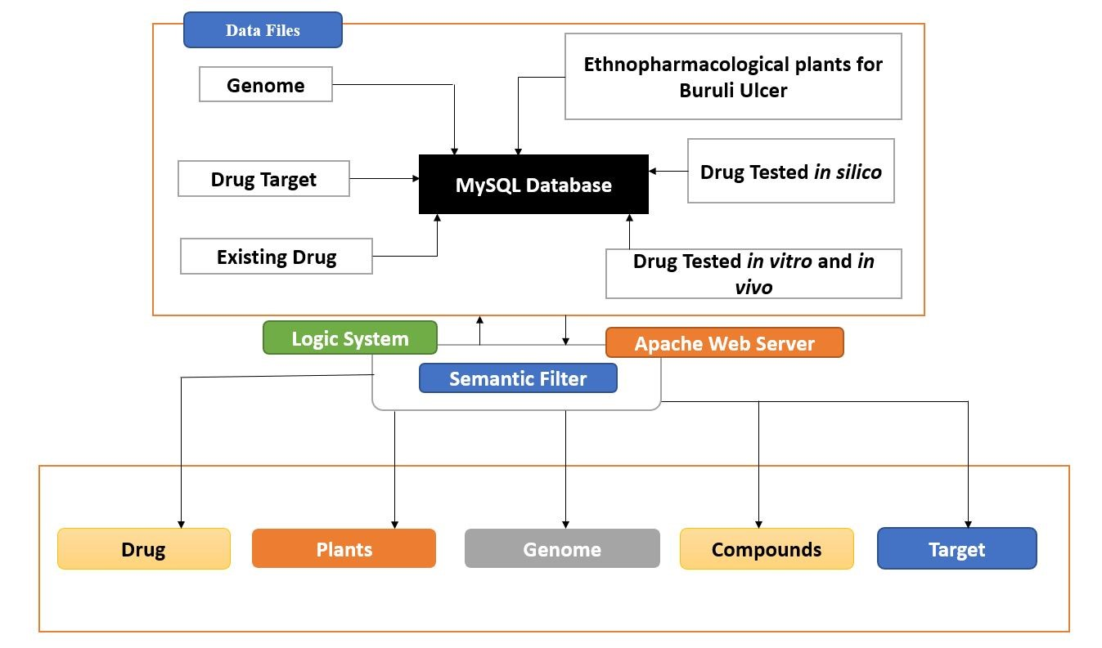
Construction of BuDb & Content

Slide 11
Results!
The BuDb has been implemented with accessibility features for querying.
BuDb is the first useful online repository of its kind integrated with enriched datasets that can aid in the discovery of new biotherapeutic entities for BU.
BuDb can be freely accessed at http://197.255.126.13:3000/.

Slide 12
Conclusion
With its enriched datasets and links to functional annotation databases, BuDb can augment the discovery of novel biotherapeutic entities for BU.
Presentation by:
Daniel Tweneboah Anyimadu
Thank you!

Slide 13


Presentation by:
Daniel Tweneboah Anyimadu
Institution:
Joint Master Student in Medical Imaging and Applications (MAIA): Université De Bourgogne (France), Universitat de Girona (Spain), and Università degli studi di Cassino e del Lazio Meridionale (Italy).

